Slide 1

Air Quality Index Analysis(AQI) in India (2015–2024)
A Data-Driven Insight into Urban Air Pollution Using Power BI
Presented by
Mohammad Alquamah Ansari
B.Sc. (Hons) Artificial Intelligence
Adiya Degree College Kakinada
(#2344210699)

Slide 2

Introduction :
Air pollution is a critical environmental and public health issue in India.
Rapid urbanization, industrial emissions, and vehicular pollution have worsened air quality in major cities.
Monitoring and analyzing Air Quality Index (AQI) over time helps identify trends, hotspots, and areas needing urgent action.
This Power BI project focuses on analyzing AQI data from 2015 to 2024, offering insights into city-wise, category-wise, and time-based air pollution patterns across India.
Air pollution is a critical environmental and public health issue in India.
Rapid urbanization, industrial emissions, and vehicular pollution have worsened air quality in major cities.
Monitoring and analyzing Air Quality Index (AQI) over time helps identify trends, hotspots, and areas needing urgent action.
This Power BI project focuses on analyzing AQI data from 2015 to 2024, offering insights into city-wise, category-wise, and time-based air pollution patterns across India.

Slide 3
Problem Statement
Lack of Real-Time Insight : Air pollution data is often unstructured and difficult to analyze without proper visualization tools.
Unidentified Trends & Patterns : Without effective analysis, it’s hard to understand which cities are consistently at risk and what pollutants dominate.
Data Complexity Across Years and Cities : With multiple pollutants, cities, and time intervals, deriving actionable insights manually is challenging.
Need for an Interactive Dashboard : A powerful visualization tool like Power BI can simplify decision-making for researchers, policymakers, and the public.

Slide 4
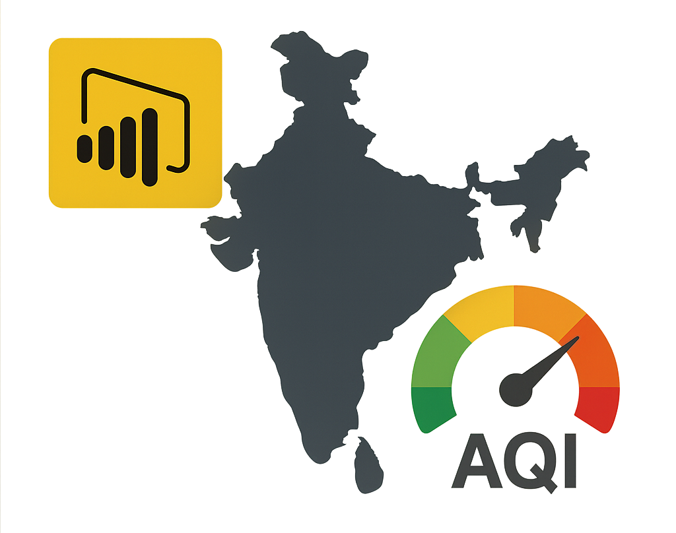
Project Objective
The primary objective of this Power BI project is to:
Analyze the Air Quality Index (AQI) data in India from 2015 to 2024.
Identify trends and patterns in pollution levels across different cities, states, and time periods.
Build an interactive and multi-page Power BI dashboard for exploring AQI metrics.
Provide actionable insights through KPI visuals, maps, filters, and comparisons.
Facilitate data-driven decision-making for awareness, planning, and pollution control.

Slide 5
Dataset Overview
Source: Air Quality Data in India (2015–2024) from Kaggle
Details:
Duration: 2015 to 2024
Records: 5.6+ million data points
Tables: city_day (used as Fact Table)
city_hour, state_hour, station_hour, stations (supporting tables)
Key Columns:Date, City, State, Station, AQI, AQI_Bucket
Pollutants: PM2.5, PM10, NO2, CO, SO2, O3, NH3
Format: CSV files with mixed time granularity (daily & hourly)

Slide 6
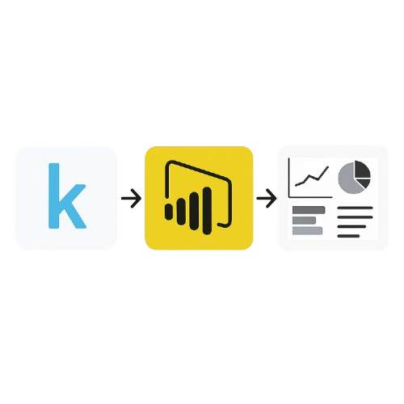
Tools & Technologies
Main Tools:
Power BI Desktop: For data import, cleaning, modeling, and visualization.
Power Query Editor: Used for extensive data cleaning and transformation operations.
Supporting Tools:
Microsoft Excel: Initial data inspection and format adjustments (if needed).
Kaggle: Source for the original dataset.
Technologies:
DAX (Data Analysis Expressions): For creating custom measures, KPIs, and calculated columns.
M Language (Power Query Formula Language): Used internally in the Power Query Editor for data transformation steps.

Slide 7
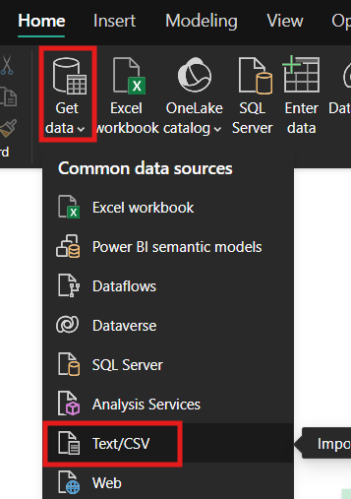
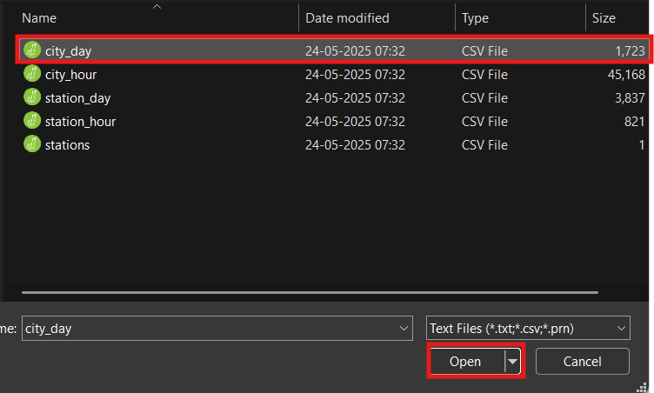
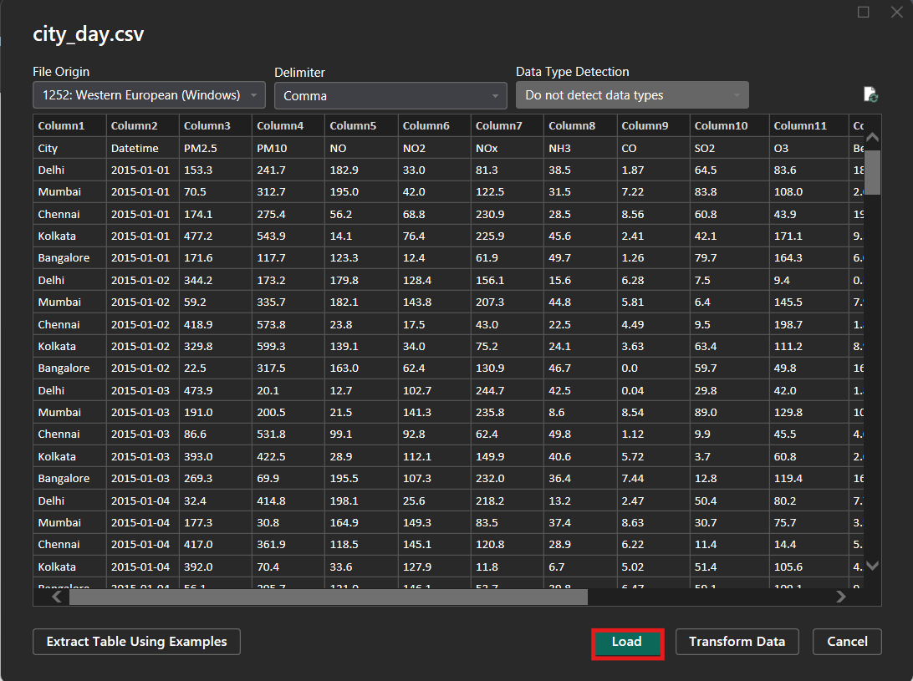
Data Loading
It is the first step in PowerBI.
Connect to data in a file :
In Power BI, on the Home tab, select Get data. In the list that displays, select the option that you require, such as Text/CSV or XML. For this example, we'll select Text/CSV .
1 2 3

Slide 8
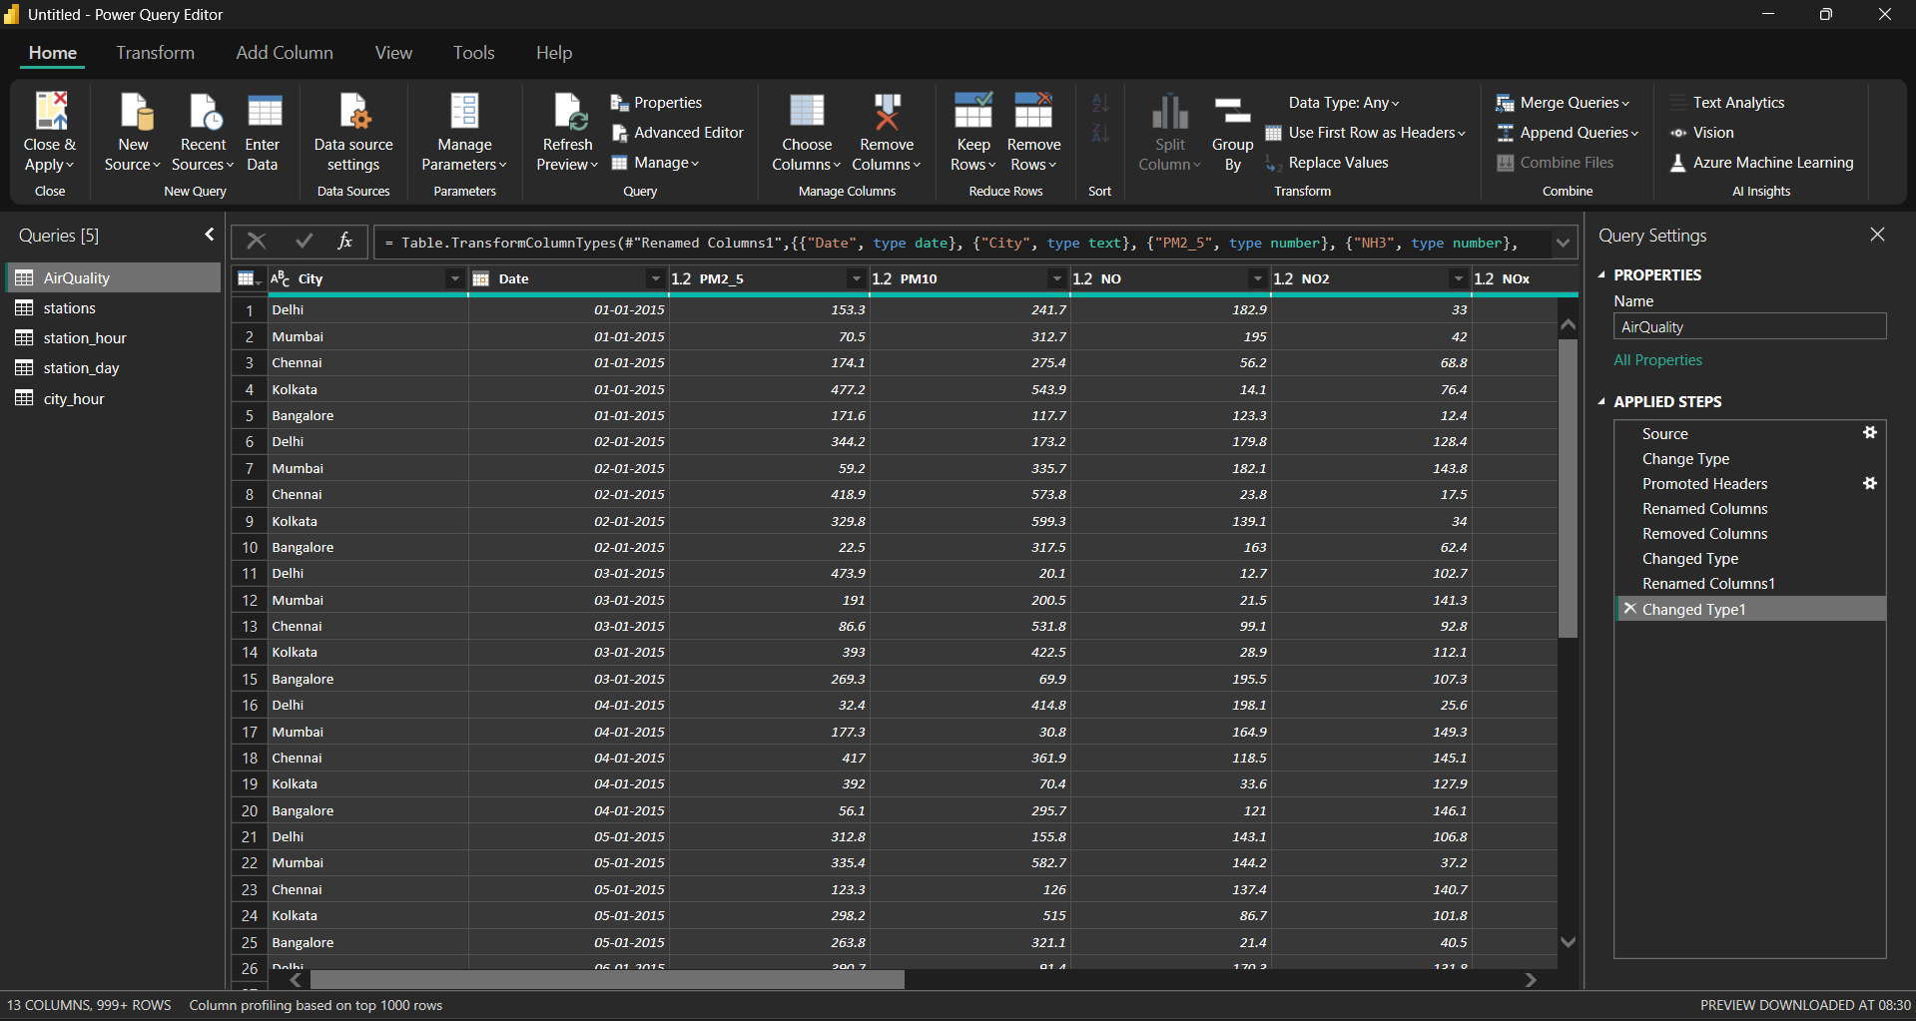
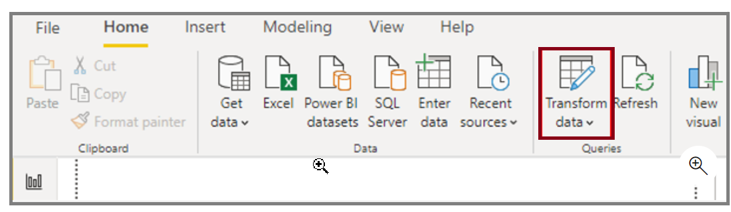
Data Cleaning in Power Query Editor
To start shaping data, open Power Query Editor by selecting the Transform data option on the Home tab of Power BI Desktop.
In Power Query Editor, the data in your selected query displays in the middle of the screen and, on the left side, the Queries pane lists the available queries (tables).
When you work in Power Query Editor, all steps that you take to shape your data are recorded. Then, each time the query connects to the data source, it automatically applies your steps, so your data is always shaped the way that you specified. Power Query Editor only makes changes to a particular view of your data, so you can feel confident about changes that are being made to your original data source. You can see a list of your steps on the right side of the screen, in the Query Settings pane, along with the query's properties.

Slide 9
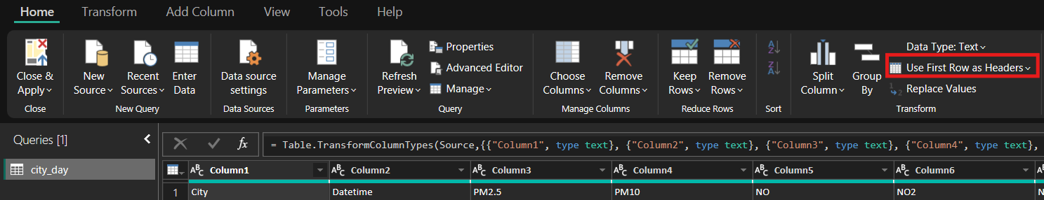
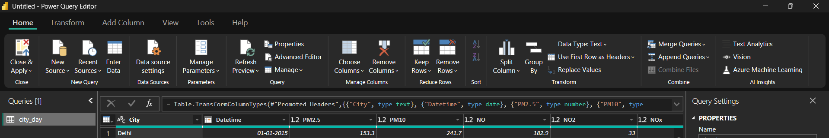
Using First Row as Headers
The first step in shaping your initial data is to identify the column headers and names within the data and then evaluate where they are located to ensure that they are in the right place.

Slide 10
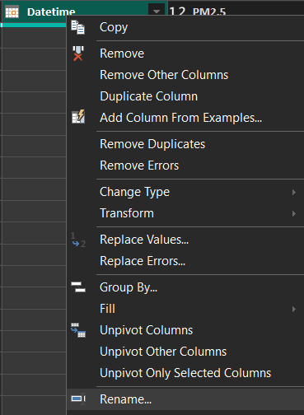
Renaming Columns
To rename the column right-click on the column header and select rename to enter new header name.
By this we can rename the column.

Slide 11
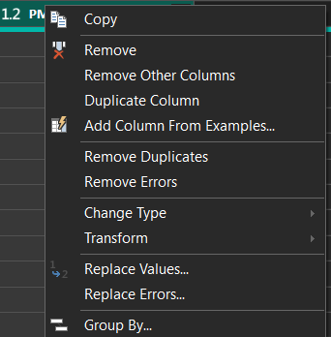

Removing Column
A key step in the data shaping process is to remove unnecessary columns. It is much better to remove columns as early as possible. One way to remove columns would be to limit the column when you get data from data source. For instance, if you are extracting data from a relational database by using SQL, you would want to limit the column that you extract by using a column list in the SELECT statement.
Removing columns at an early stage in the process rather than later is best, especially when you have established relationships between your tables. Removing unnecessary columns will help you to focus on the data that you need and help improve the overall performance of your Power BI Desktop semantic models and reports.
Examine each column and ask yourself if you really need the data that it contains. If you don't plan on using that data in a report, the column adds no value to your semantic model. Therefore, the column should be removed. You can always add the column later, if your requirements change over time.
You can remove columns in two ways. The first method is
to select the columns that you want to remove and then,
on the Home tab, select Remove Columns.
Alternatively, you can select the columns that you want
to keep and then, on the Home tab, select Remove
Columns > Remove Other Columns.

Slide 12
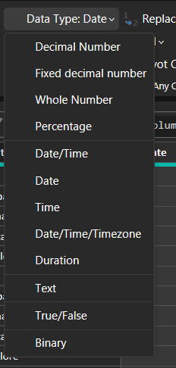
Detecting & Changing Data Types
To change the datatype of the column data we have to select the column and then follow the steps as
Transform Any Column DataType

Slide 13
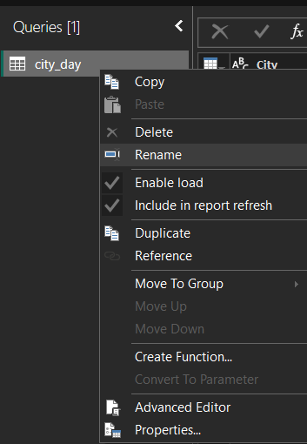
Renaming Table
It's good practice to change uncommon or unhelpful query names to names that are more obvious or that the user is more familiar with. For instance, if you import a product fact table into Power BI Desktop and the query name displays as FactAirQuality, you might want to change it to a more user-friendly name, such as AirQuality.

Slide 14
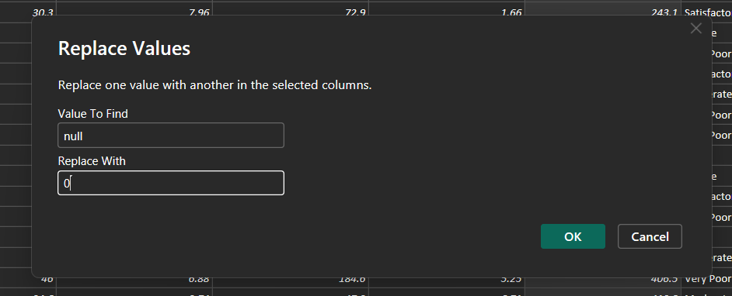
Removing & Nulls
Occasionally, you might find that your data sources contain null values. For example, a freight amount on a sales order might have a null value if it's synonymous with zero. If the value stays null, the averages will not calculate correctly. One solution would be to change the nulls to zero, which will produce the more accurate freight average. In this instance, using the same steps that you followed previously will help you replace the null values with zero.

Slide 15
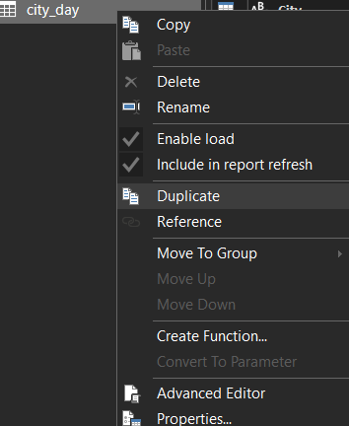
Remove duplicates
You can also remove duplicates from columns to only keep unique names in a selected column by using the Remove Duplicates feature in Power Query.

Slide 16
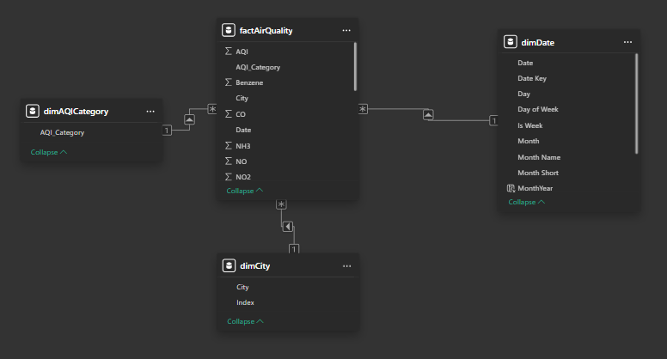
Data Modeling
Fact Table:
factAirQuality (based on city_day): Contains measurable values like AQI, pollutants, date, and city.
Dimension Tables Created:
dimCity – City names, used for filtering and slicing.
dimDate – Custom date table with Year, Month, Quarter, Day.
dimAQIBucket – Descriptions for AQI categories.
dimPollutantType – Optional table for pollutant names.
Relationships:
One-to-many relationships between
factAirQuality and dimension tables.Ensured
correct cardinality and cross-filter direction (mostly
single).
Schema Design: Star Schema used for optimal performance
and simplicity.

Slide 17
Creating & Using dimDate Table
why dimDate?
Enables time-based analysis: Yearly, Monthly, Quarterly trends.
Required for date hierarchies in visuals (e.g., line/area charts).
Steps to create dimDate:
Open Power BI > Modeling > New Table
DAX formula:
dimDate = ADDCOLUMNS (
CALENDAR (DATE(2015,1,1), DATE(2024,12,31)),
"Year", YEAR([Date]),
"Month Number", MONTH([Date]),
"Month Name", FORMAT([Date], "MMMM"),
"Quarter", "Q" & FORMAT([Date], "Q")
)

Slide 18

Finalized Power BI Data Model
Model Overview:
Centered around the factAirQuality table.
Connected dimension tables:
dimDate → for temporal analysis.
dimCity → to filter by city.
dimAQIBucket → for AQI categories.
Relationships:
One-to-Many (e.g., dimCity[City] ➝ factAirQuality[City])
Cross Filter Direction: Mostly Single for performance and clarity.
Avoided circular references or inactive relationships.
Schema Type:
Star Schema implemented for clean, efficient querying.

Slide 19
Power BI Report Design Strategy
Objective: To deliver a clean, interactive, and user-friendly dashboard showcasing Air Quality Index trends and insights across India.
Design Principles Followed:
Modular Layout: Multiple pages for different insights (Overview, City-wise, Yearly Trends, etc.)
Purpose-Driven Pages: Each report page focuses on a specific analysis goal.
Consistent Theme: Custom background, uniform colour palette, and font styles used across all pages.
Visual Variety: Bar, column, line, area, KPI, donut, slicers, matrix, and more.
Interactivity: Filters, slicers, drill-downs, and tooltips implemented.

Slide 20
National AQI Overview
Purpose: To provide a high-level summary of India's air quality trends over the years.
Key Visuals Used:
KPI Cards: Display average AQI, total number of records, number of cities.
Bar Chart: Top cities with highest average AQI.
Line Chart: Year-wise average AQI trend across India.
Donut Chart: AQI Bucket distribution (Good, Satisfactory, Moderate, etc.)
Slicers: Year and City slicers for dynamic filtering.

Slide 21
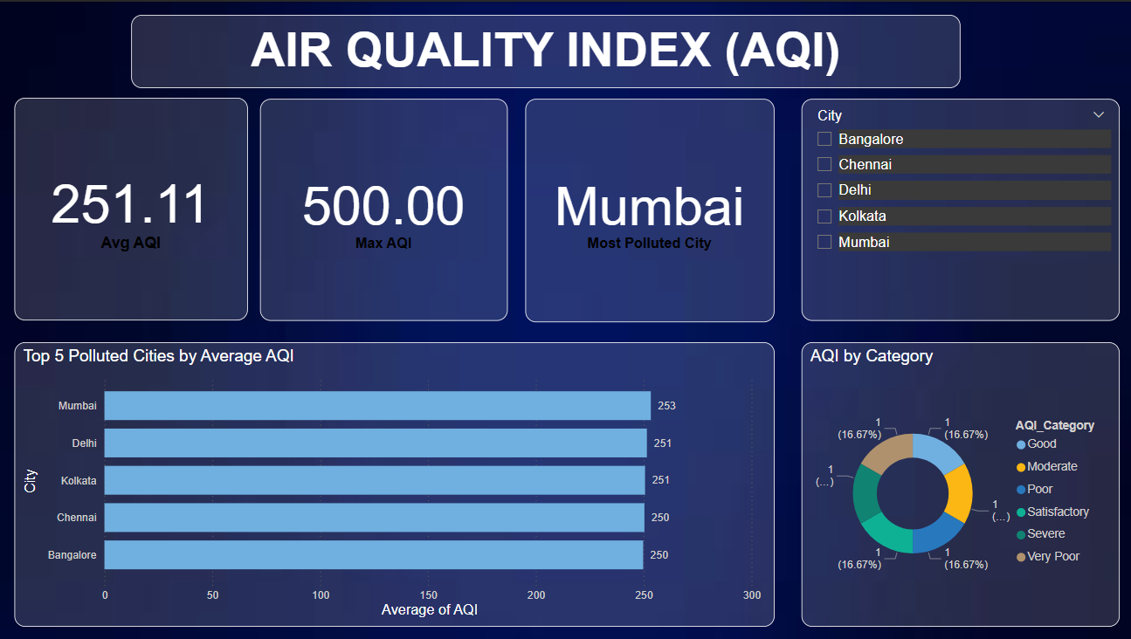
Overview
Dashboard Overview: This report page provides a high-level summary of the overall Air Quality Index (AQI) across major Indian cities using visual KPIs and categorical breakdowns.
Key Insights:
Average AQI: 251.11 – Indicates a generally unhealthy air quality level.
Maximum AQI Recorded: 500 – Critical air pollution level, possibly due to industrial or traffic sources.
Most Polluted City: Mumbai – Exhibits the highest average AQI (253).
Visuals Used:
KPI Cards: Display Avg AQI, Max AQI, and Most Polluted City.
Slicer (City Filter): Enables user to filter visualizations by individual cities.
Bar Chart: Top 5 Polluted Cities by Average AQI – Mumbai, Delhi, Kolkata, Chennai, Bangalore.
Donut Chart: AQI by Category – Even distribution across categories such as Good, Moderate, Poor, etc.

Slide 22
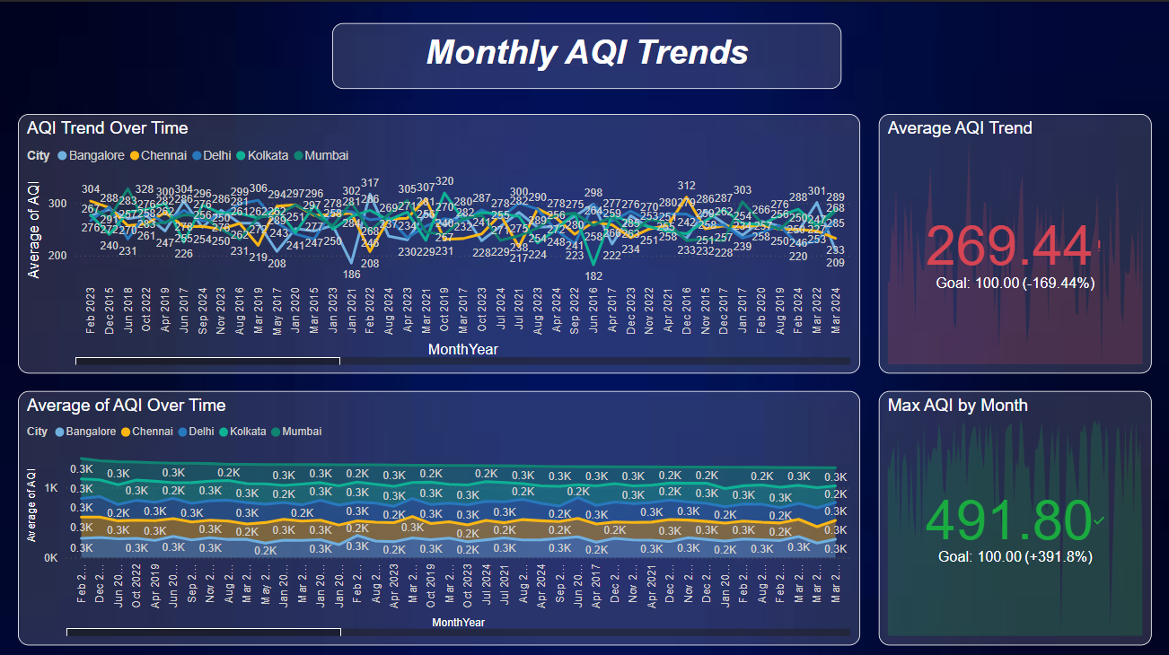
Monthly AQI Trends
Key Visuals & Metrics:
Line Chart (Top): AQI Trend Over TimeTracks monthly average AQI for Bangalore, Chennai, Delhi, Kolkata, Mumbai. Reveals seasonal patterns, with notable peaks and drops (e.g., extreme low in Jan 2021 at AQI 182).
Stacked Area Chart (Bottom): Average AQI Distribution Over TimeDemonstrates how AQI contributions from each city evolved over the timeline. Highlights consistency and fluctuations across cities.
KPI Cards: Average AQI Trend: 269.44 vs. Goal 100.00 → 169.44% over target.Max AQI by Month: 491.80 → Alarming level, 391.8% above goal.
Interpretation:
Air quality remains consistently unhealthy across the decade.Seasonal variations are visible, with spikes often occurring during winter months due to atmospheric conditions and pollution accumulation.
The data indicates no consistent long-term improvement, highlighting the urgency for sustained interventions.

Slide 23
Identifying the Cities with Highest AQI Levels (2015–2024)
This page presents a comprehensive ranking of the five most polluted cities in India based on cumulative AQI values over the last decade.
Key Visuals & Insights:
KPI Cards:
Average AQI Trend: 269.44 vs. Goal 100.00 → 169.44% above safe level.
Max AQI by Month: 491.80 → 391.8% above ideal threshold.
AQI Summary Table:
City-wise annual average AQI from 2015 to 2024.
Mumbai recorded the highest cumulative average: 253.32, followed by Delhi (251.50) and Kolkata (250.64).
Overall AQI remains consistently high across all cities over the years.

Slide 24
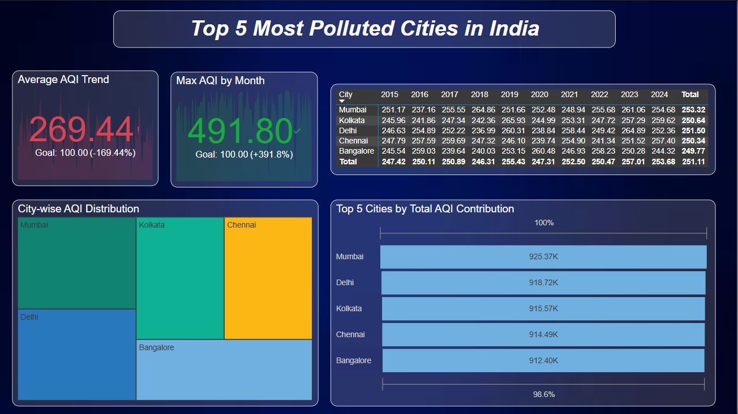
Treemap – City-wise AQI Distribution:
Shows visual dominance of AQI by city.
Mumbai occupies the largest share, reflecting its high contribution to overall pollution levels.
Bar Chart – Total AQI Contribution (2015–2024):
Top 5 Cities by Total AQI:
Mumbai: 925.37K
Delhi: 918.72K
Kolkata: 915.57K
Chennai: 914.49K
Bangalore: 912.40K
These five cities contribute 98.6% of the total AQI data analyzed.
Interpretation:
Mumbai, Delhi, and Kolkata emerge as the top three most polluted cities.
Despite being metro hubs, all five cities consistently exceed healthy AQI limits.
Highlights the urgent need for city-specific pollution control measures.

Slide 25
Conclusion
Project Summary
Analyzed Air Quality Index (AQI) trends across India from 2015 to 2024.
Used Power BI for data cleaning, modeling, and interactive visualization.
Focused on key dimensions: year, city, season, pollutant type, and monthly trends.
Key Insights
No city met the AQI goal of 100 in any year — critical air quality concerns persist.
Delhi and Mumbai consistently recorded the highest pollution levels.
Winter and post-monsoon seasons showed significant AQI spikes, likely due to low dispersion and increased emissions.
PM2.5 and PM10 are the most dominant pollutants across all regions.
Air quality worsened between 2015–2020, with slight improvement post-pandemic years.

Slide 26
Recommendations Strengthen urban air pollution control policies in top 5 cities. Implement seasonal interventions, especially during winters. Promote green energy, public transport, and industrial emission regulations. Encourage citizen awareness and participation through real-time AQI apps and alerts. Future Scope Extend analysis to include real-time monitoring, health impact, and satellite data integration. Build predictive models for forecasting AQI trends and risk levels.

Slide 27
Thank You

